Slide 1
US Accidents Analysis
Ahmed Osama Helmy Abdallah Ahmed
Aliaa Gheis Omar Mahmoud

Slide 2
Problem Definition
Road safety is a critical concern, and understanding accident patterns can help cities improve traffic management and reduce accident rates.
This project aims to analyze accident data to identify high-risk locations, contributing factors, and potential mitigation strategies.
By leveraging big data processing, we will extract valuable insights for transportation authorities and urban planners.

Slide 3
From Data to Insights
Data Exploration
Data Visualization
Data Cleaning
Feature Engineering
Aggregation or using models
Visualizing & Extracting Insights

Slide 4
Data Exploration/Visualization

Slide 5
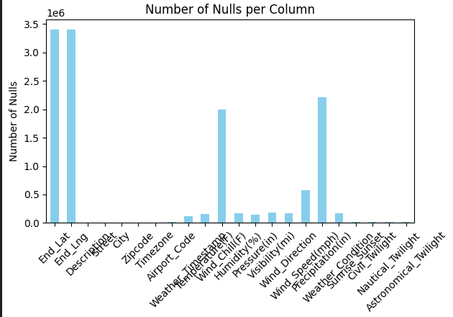
Nulls in Data
Some Columns have a lot of missing values

Slide 6
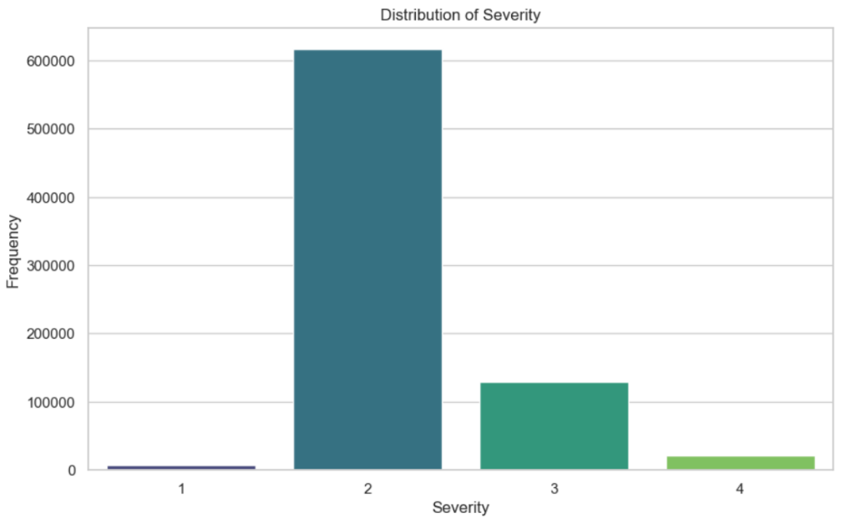
Severity Distribution
Severity 2 is dominating

Slide 7
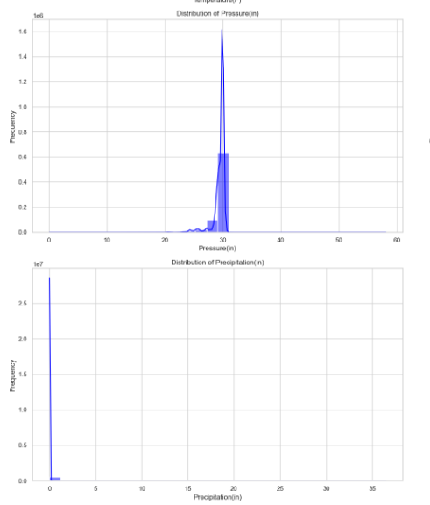
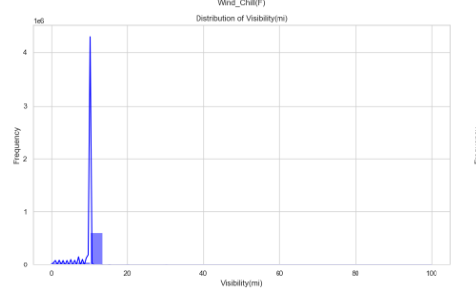
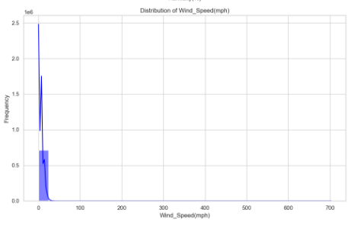
Outliers
Some columns have outliers

Slide 8
Accidents based on Time

Slide 9
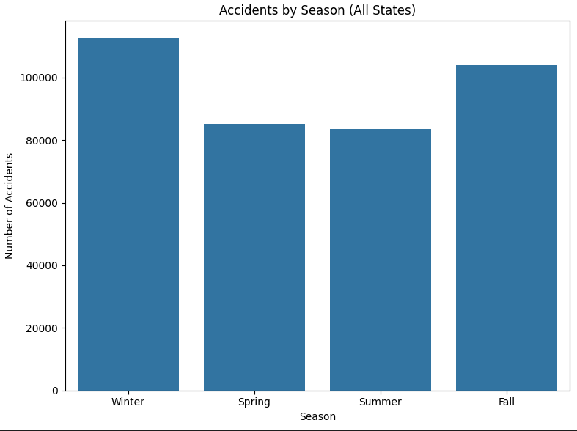
Accident Trends by Season.

Slide 10
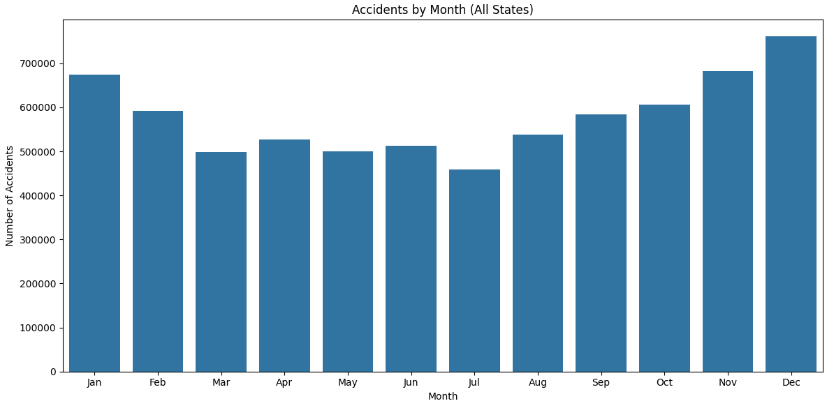
Accident Trends by Month.

Slide 11
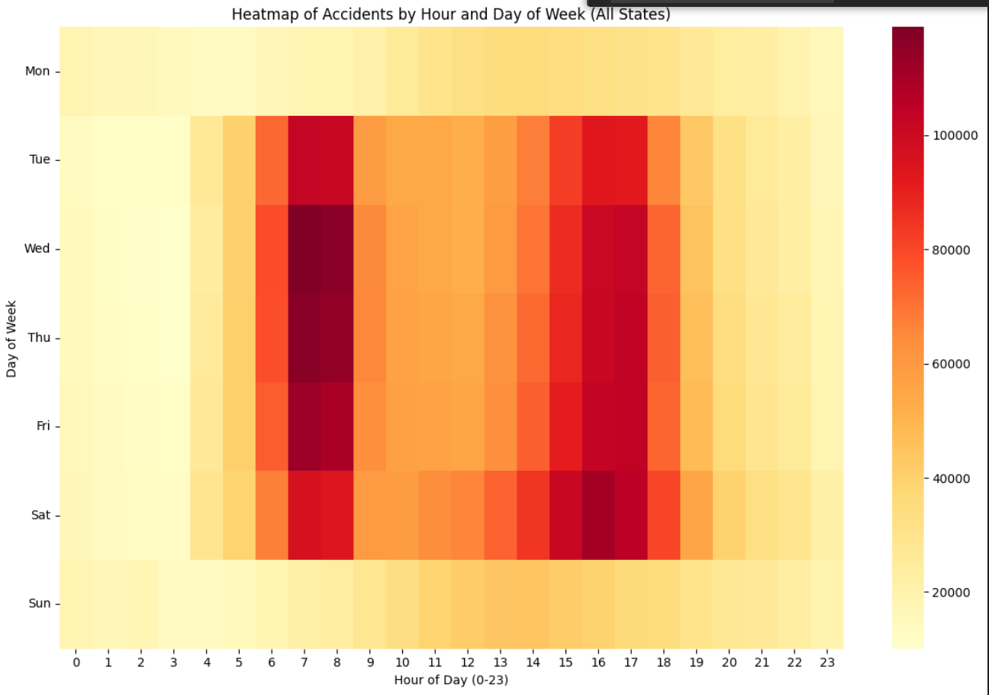
Accident Trends by Hour.

Slide 12
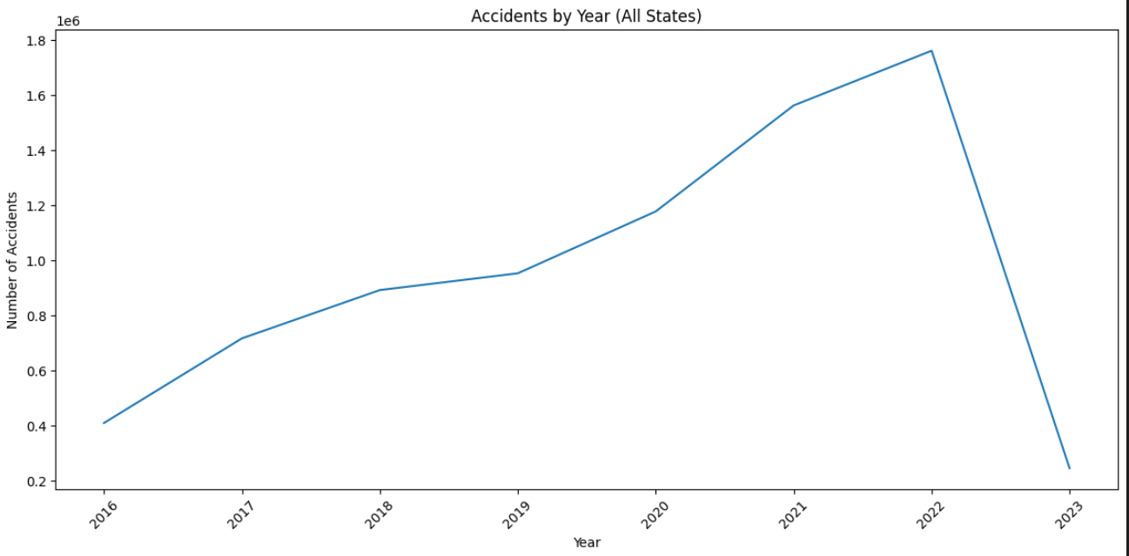
Accident Trends by Year.

Slide 13
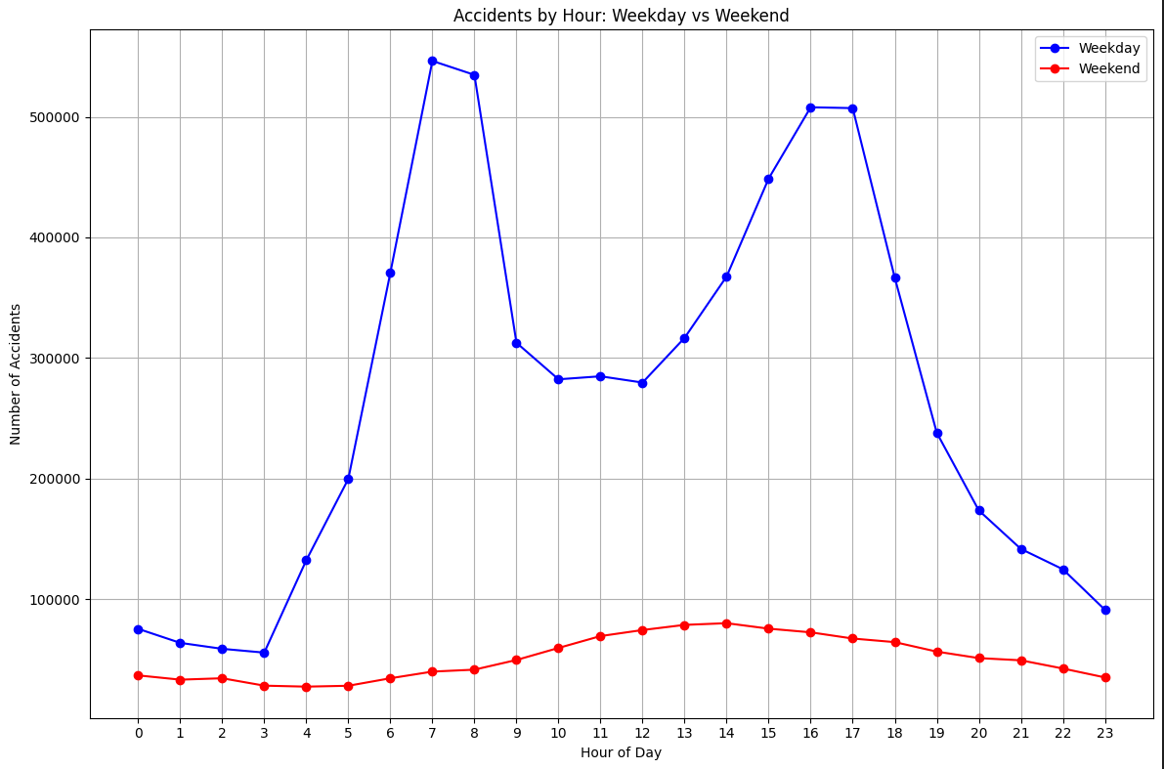
Weekends and Weekdays behavior

Slide 14
Weather Effect on Accidents

Slide 15
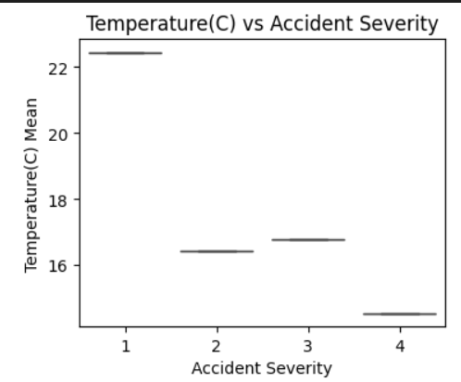
Temperature & Severity

Slide 16
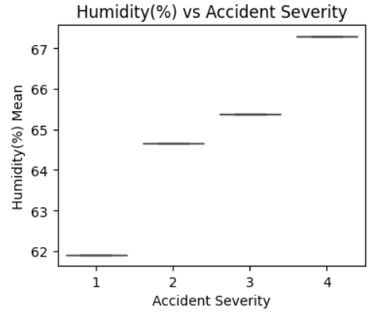
Humidity & Severity

Slide 17
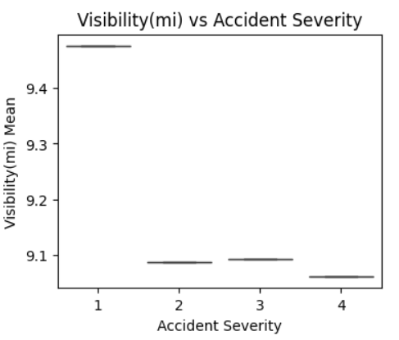
Visibility & Severity

Slide 18
Accidents based on Location

Slide 19
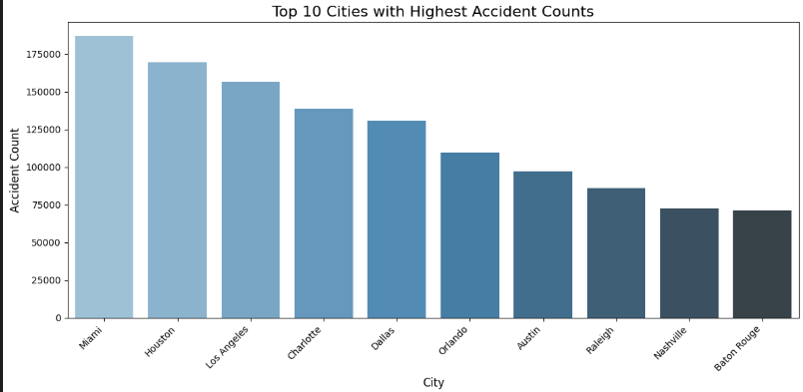

Slide 20
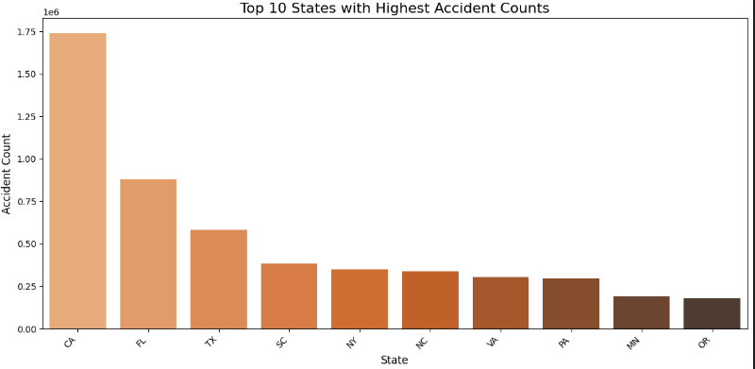

Slide 21
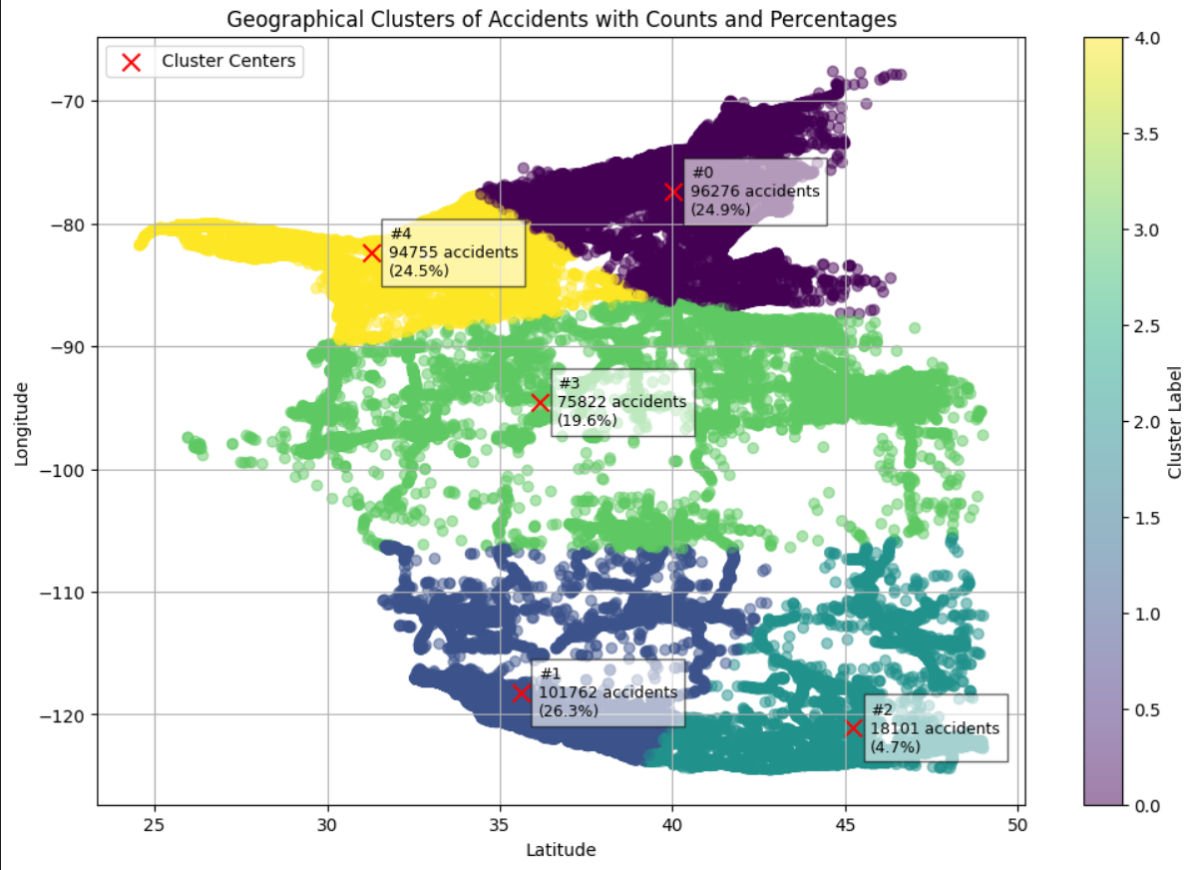
Top 5 Clusters in US with Accidents

Slide 22
Road Conditions & Accidents

Slide 23
Technical Details

Slide 24
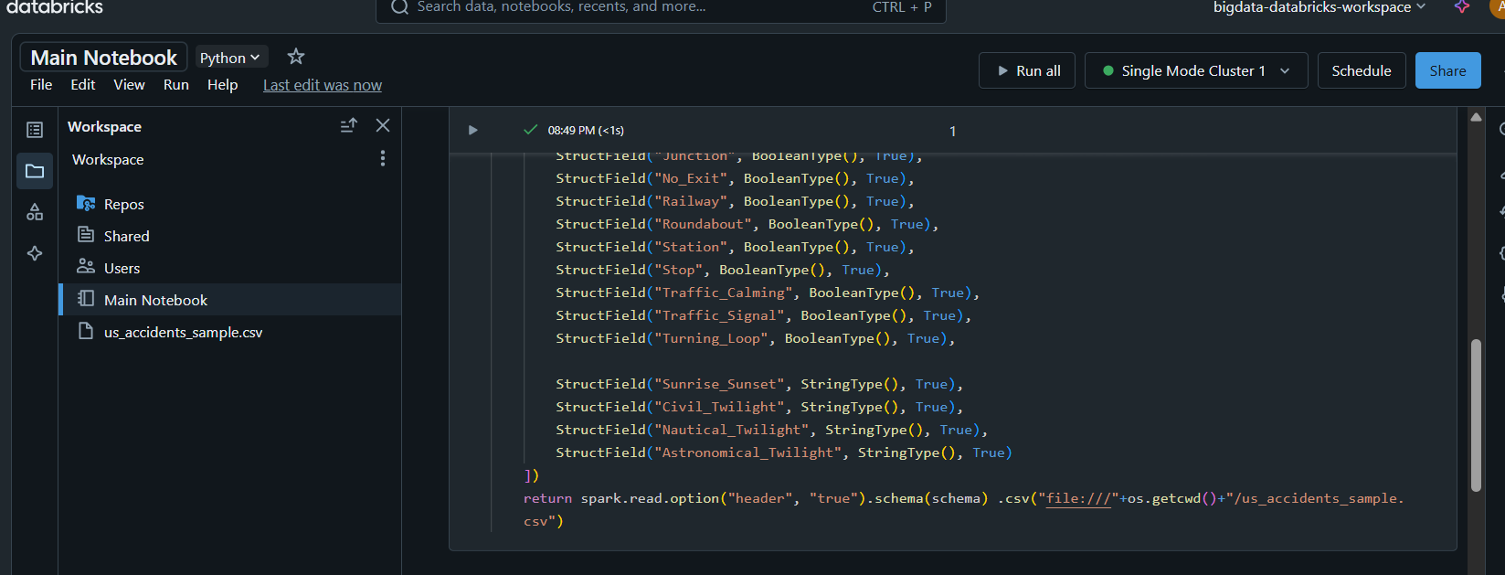
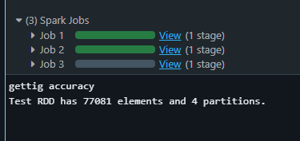
Azure Databricks

Slide 25
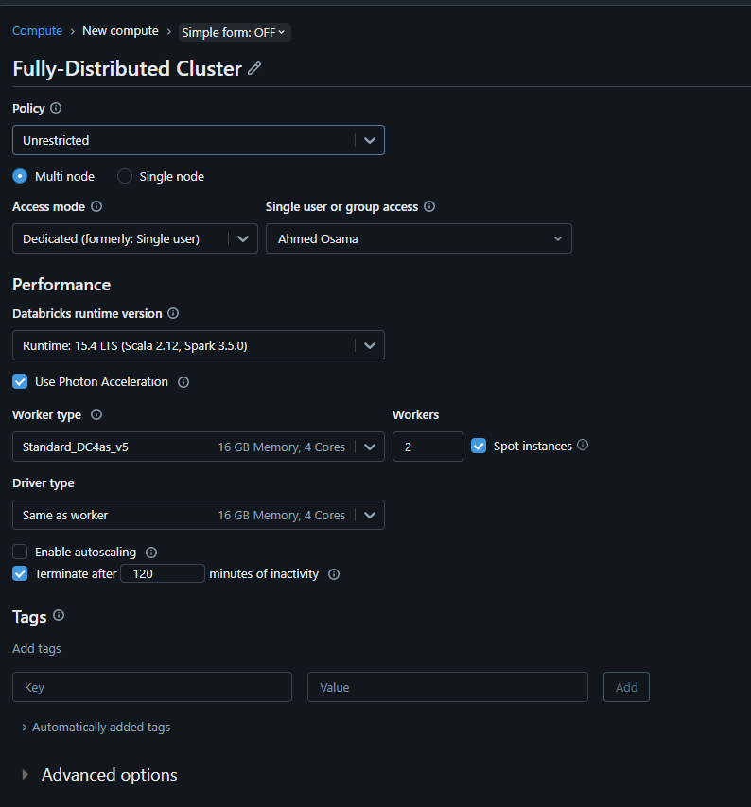

Fully Distributed Mode

